Slide 1
Anaesthetic Chart Documentation: Is It Up To Scratch?
Dr Melissa Hartley
21st September 2021
Dr MK Varma Memorial Prize Meeting

Slide 2
Background
Accurate anaesthetic chart documentation is important both for clinicians involved in ongoing patient care and medicolegally
Northumbria Healthcare NHS Foundation Trust is working towards Anaesthesia Clinical Services Accreditation (ACSA) from the Royal College of Anaesthetists
ACSA standards are based on Guidelines for the Provision of Anaesthetic Services. Several standards relate to documentation
GMC also sets out standards for all medical documentation
Audit performed to evidence compliance and highlight any areas where improvement required

Slide 3
GMC Standards Good Medical Practice
Domain 1 - Knowledge, skills and performance

Slide 4
ACSA Standards Supervision

Slide 5
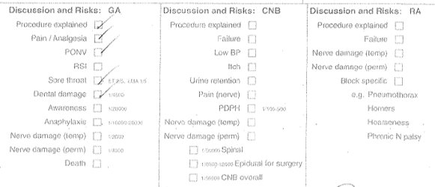
ACSA Standards Discussion of Risks

Slide 6
ACSA Standards Machine Check

Slide 7
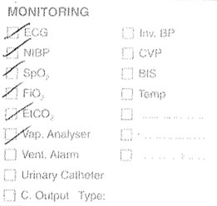
ACSA Standards Monitoring

Slide 8
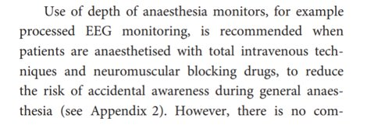
Minimum Monitoring Guidelines Recommendations for standards of monitoring during anaesthesia and recovery (2015)

Slide 9
ACSA Standards Handover

Slide 10
Methods
Audit completed by F2 doctor under supervision of consultant anaesthetist
From guidelines, created list of criteria which should be documented on all anaesthetic charts
Reviewed random selection of anaesthetic charts to see which criteria met
Inclusion criteria: patient received a general anaesthetic
Exclusion criteria: spinal and/or sedation only
Charts reviewed shortly post-operatively either in recovery or in critical care after transfer from recovery
Multiple sites within the trust included - NSECH, Wansbeck General Hospital and North Tyneside General Hospital

Slide 11
Methods
28 anaesthetic charts reviewed over a 1 week period in late 2019
All anaesthetists within the department emailed with results and relevant guidelines
Areas needing particular improvement flagged up in email
Reaudit performed with a further sample of 25 charts after a period of 1 month
Results presented to all anaesthetists in the department at clinical governance meeting

Slide 12
Results Anaesthetist details
Anaesthetist name - 96.4% → 80%
Anaesthetist grade - 10.7% → 16%
GMC number - 0% → 4%
Signature - 0% → 8%
If trainee - supervising consultant - 88.9% → 91.7%
If trainee - level of supervision - 11.1% → 25%

Slide 13
Results Patient/anaesthetic details
ASA grade - 92.9% → 80%
NCEPOD Class - 39.3% → 20%
Discussion of risks - 78.6% → 84%
Anaesthetic plan - 69.7% → 48%
Machine check - 75% → 56%

Slide 14
Results Monitoring
ECG, NIBP, SpO2, vapour analyser - all 100%
FiO2 - 100% → 96%
EtCO2 - 96.4% → 100%
Airway pressures - 20% → 40%
BIS - 90% → 100%
Temperature - 73.1% → 70.8%

Slide 15
Results Handover to recovery
Boxes checked - 50% → 48%
Written information - 25% → 28%
Cannula flush box checked - 42.9% → 32%
Signed - 46.4% → 32%

Slide 16
Conclusions
Minimal overall change seen on reaudit
Documentation of intraoperative observations and monitoring used generally met the required standards
Areas of weakness included documentation of full anaesthetist identifying details and handover to recovery
Overall documentation still falls short of standards set out by RCoA and GMC

Slide 17
What Next?
Audit put on hold due to covid pandemic!
Updated ACSA standards published in 2021
New minimum monitoring guidelines published by AAGBI 2021
Reaudit started to assess for any change/compliance with new guidelines
Unclear whether discussion raised at the initial presentation of results will have changed practice

Slide 18
Thank you!

